Slide 1
Geometry

Slide 2
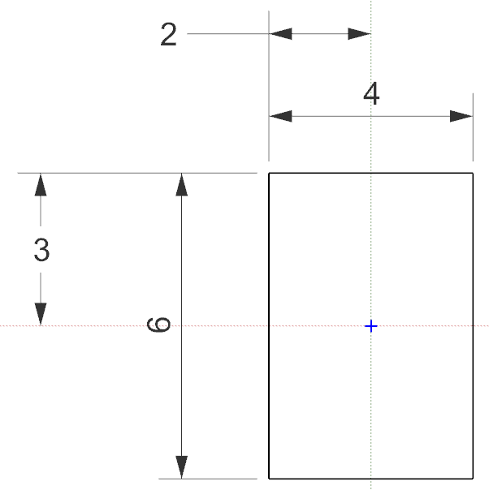
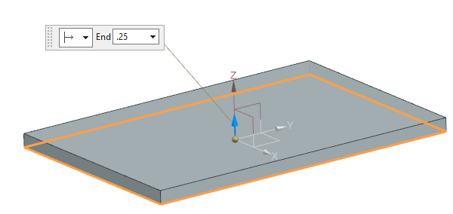
Feature Name: Base
Feature Type: Extrude
Centered at 0,0,0
Extrude in +Z direction

Slide 3
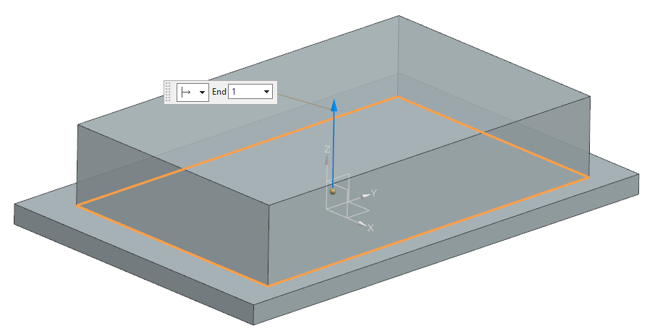
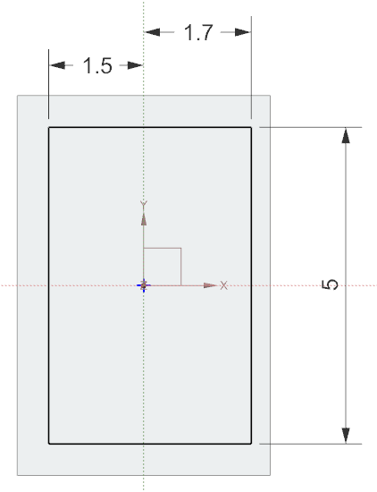
Feature Name: Raised_Base
Feature Type: Extrude
Not centered

Slide 4
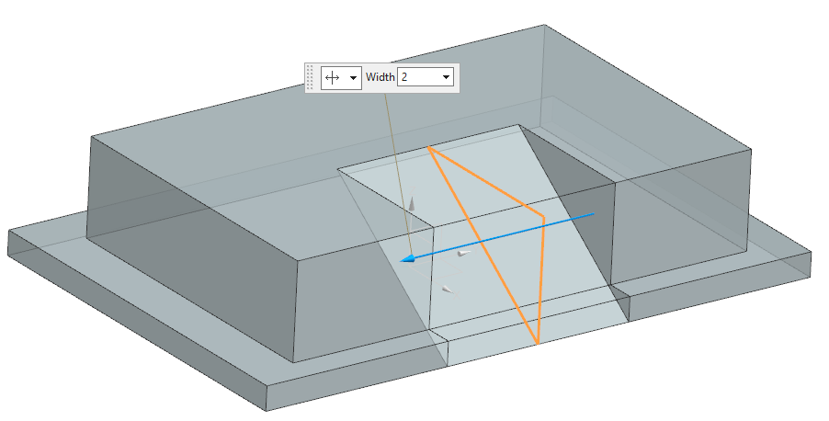
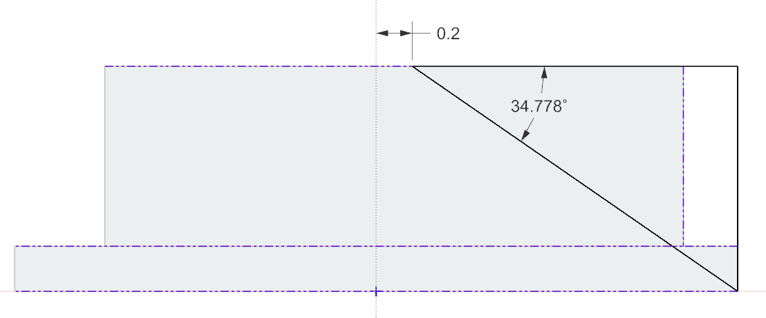
Feature Name: Ramp
Feature Type: Extruded Cut
Sketch on XZ plane
Cut 1.0 in each direction
Total cut distance 2.0
Coincident

Slide 5
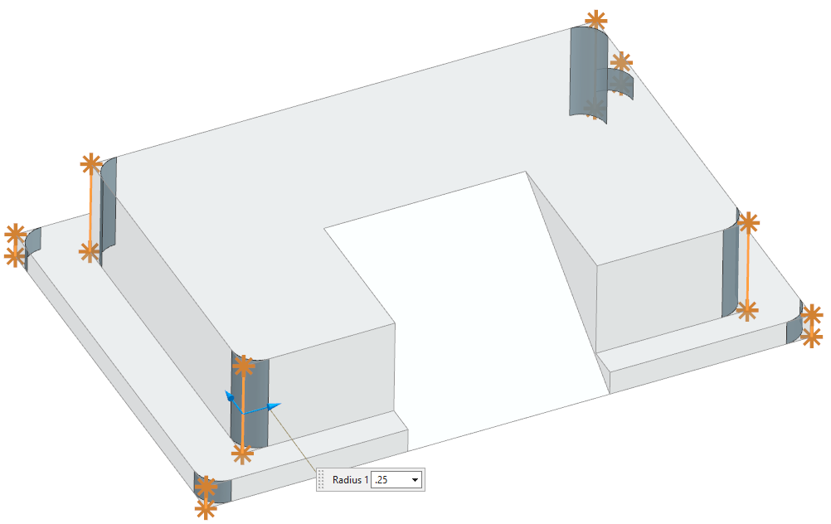
Feature Name: Vertical_Edges_Blend
Feature Type: Fillet
Radius .25

Slide 6
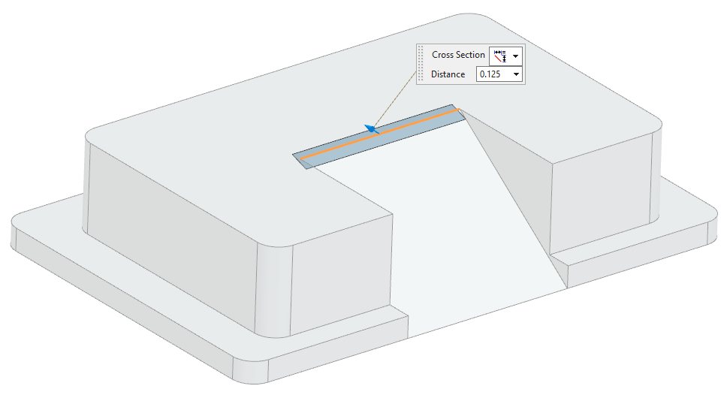
Feature Name: Chamfer
Feature Type: Chamfer
Symmetric
.125

Slide 7
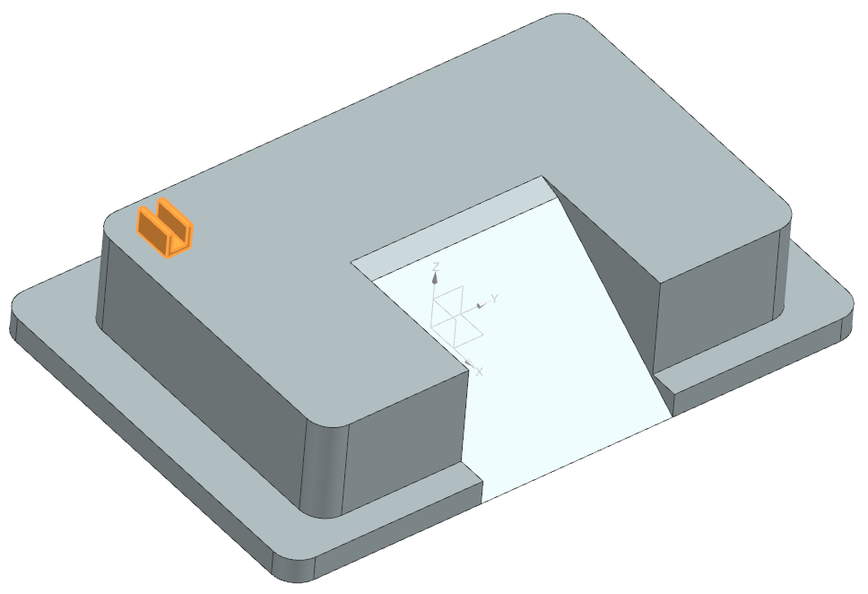
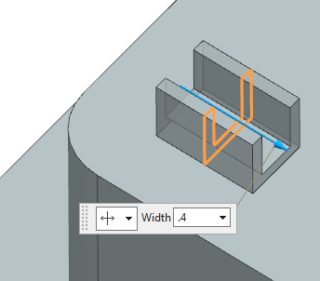
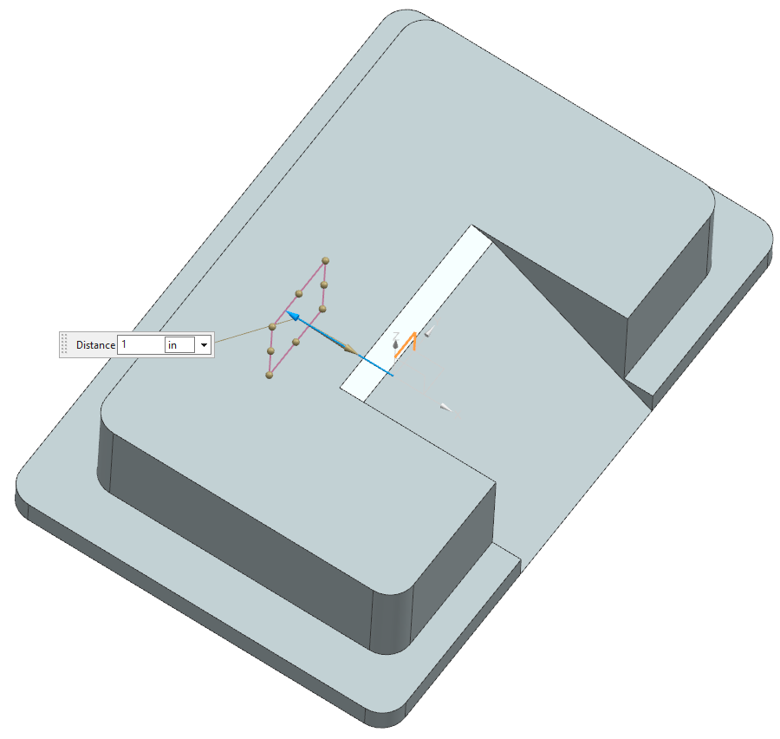
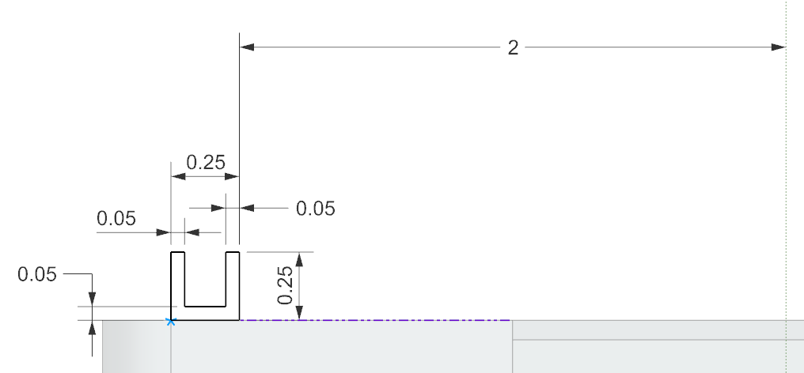
Feature Name: Clip
Feature Type: Extrude
Extrude .2 in each direction
Total extrude distance .4
Sketched on plane 1.0 in offset from YZ plane

Slide 8
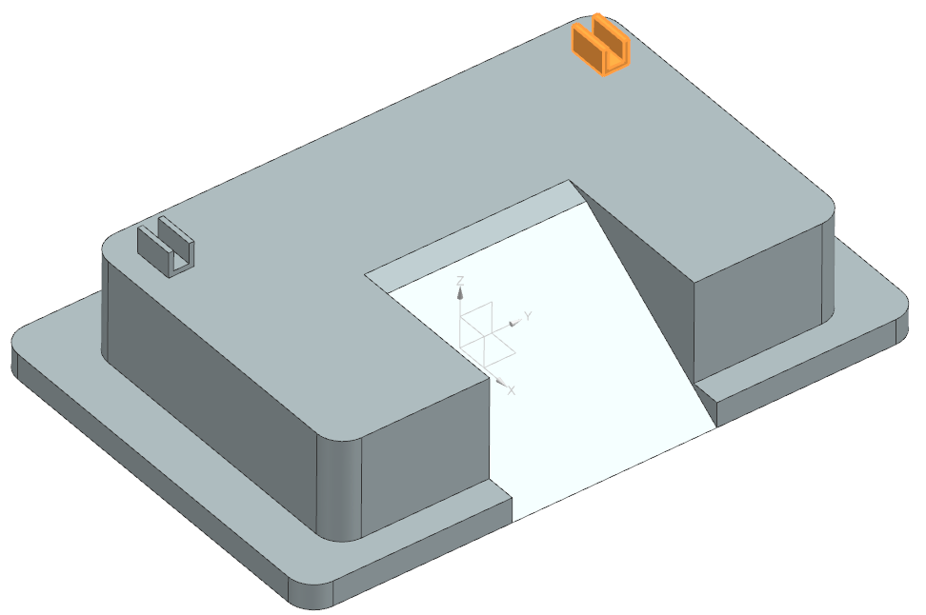
Feature Name: Clip_Mirror
Feature Type: Mirror
Mirror on XZ plane

Slide 9
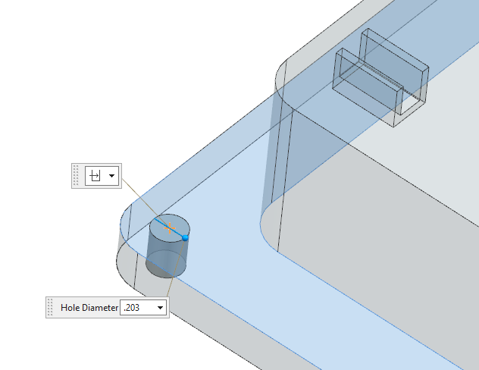
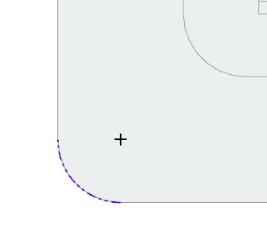
Feature Name: 1-THRU-ALL
Feature Type: Hole
Create one hole, it will be patterned in the next feature
Concentric
Use the Thru All option
for depth
Diameter .203

Slide 10
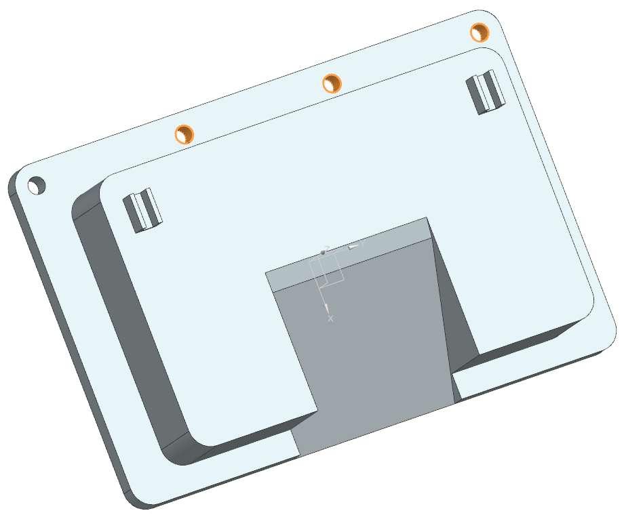
Feature Name: 2-LINEAR_PATTERN
Feature Type: Pattern
Distance = 1.83 between holes
In the Y direction

Slide 11
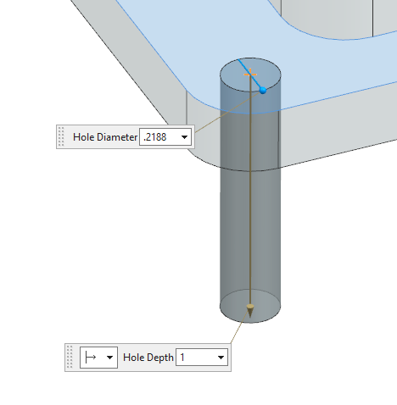
Feature Name: 3-NUMERIC_THRU
Feature Type: Hole
Concentric
Diameter .2188
Depth is a value of 1.0
*NOT Thru All* but large enough to go through the base

Slide 12
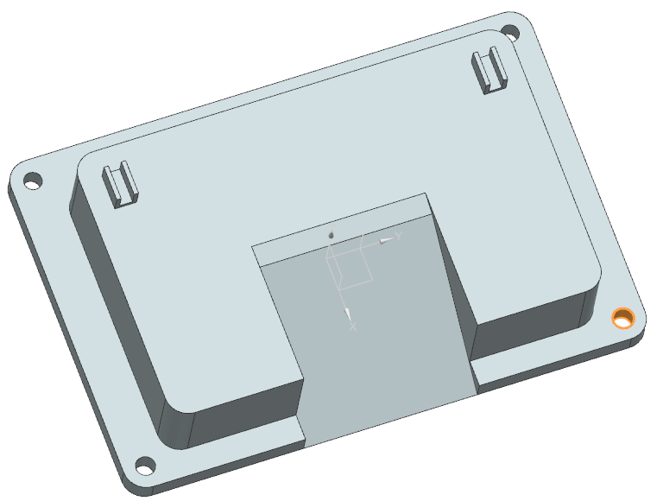
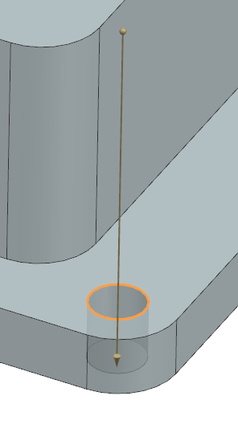
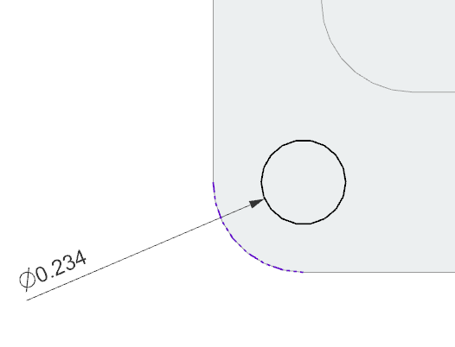
Feature Name: 4-SKETCH_EXTRUDE_THRU_ALL
Feature Type: Extrude
*This is intentionally a sketch that is extruded.
Circular Sketch Concentric to radiused edge
Depth is Thru All in both directions

Slide 13
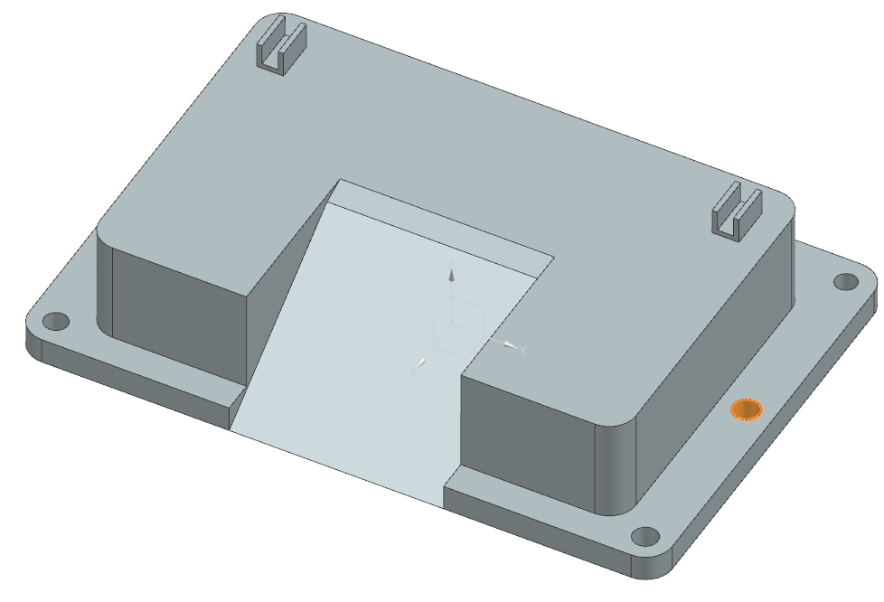
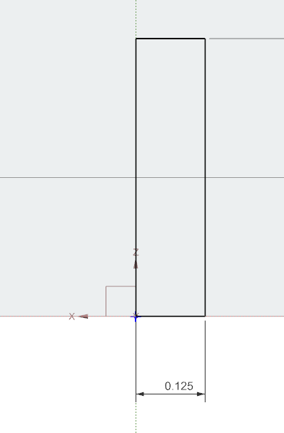
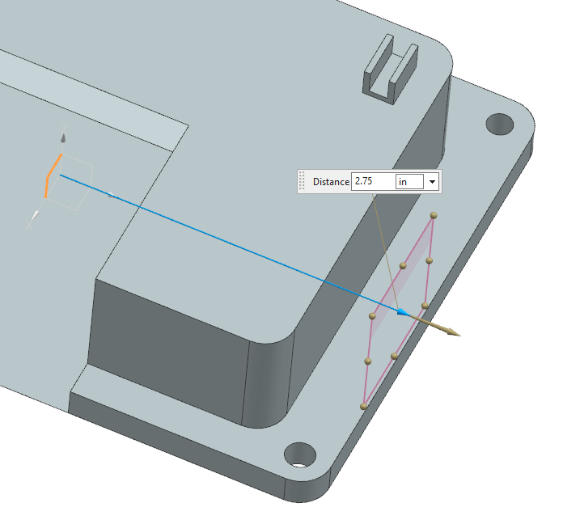
Feature Name: 5-REVOLVE_THRU_ALL
Feature Type: Revolved Cut
*This is intentionally a revolved cut feature.
Axis aligned with YZ plane
Sketch plane 2.75 offset from XZ plane
Width (Radius) .125
Height (Depth) larger than base thickness

Slide 14
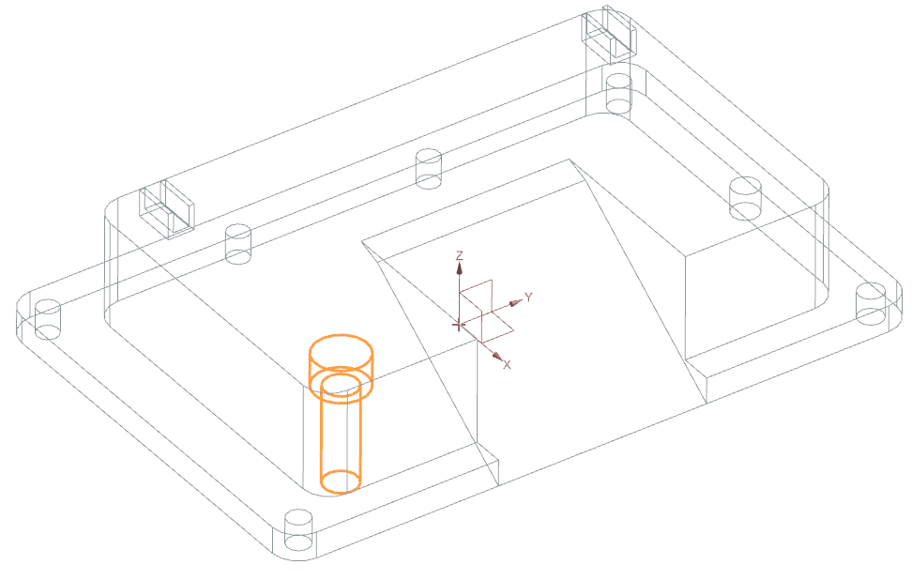
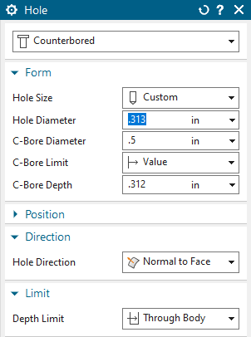
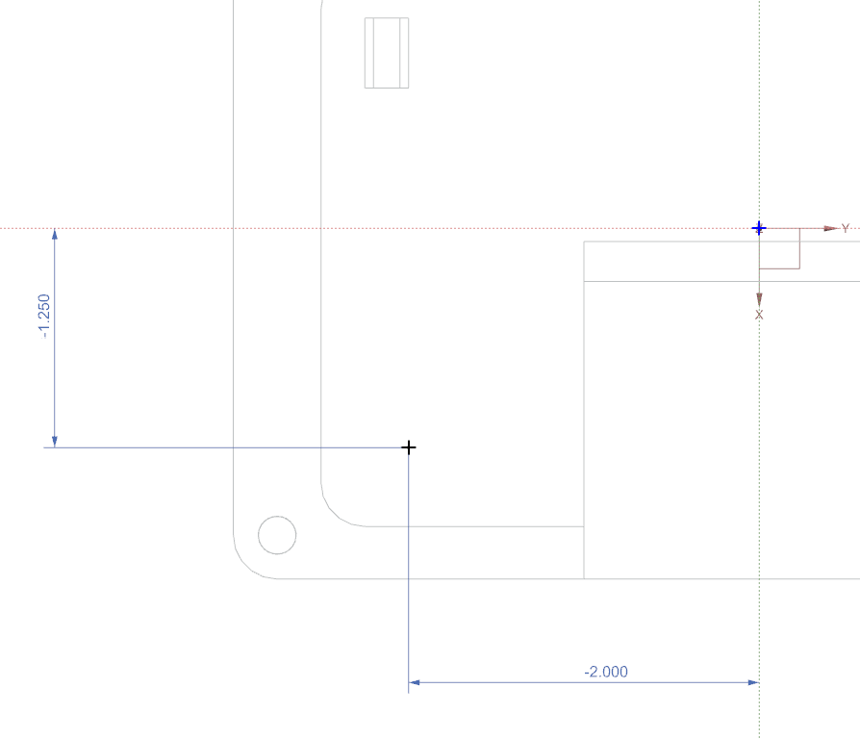
Feature Name: 6-COUNTERBORE_THRU
Feature Type: Hole (Counterbored)

Slide 15
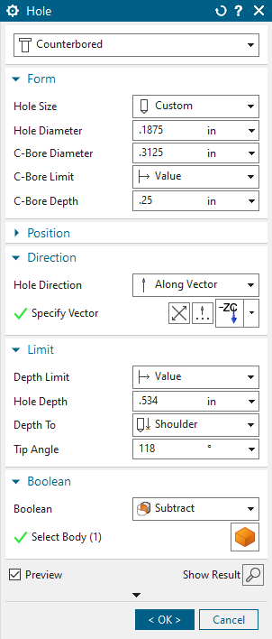
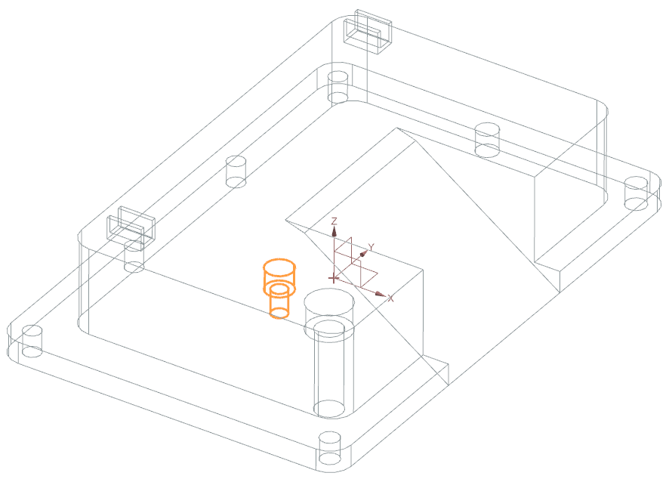
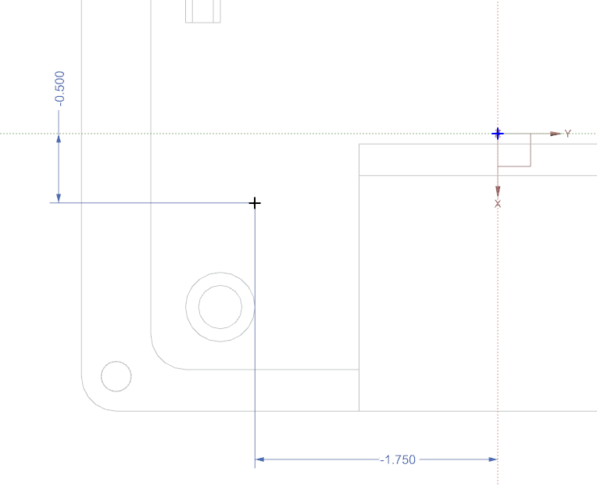
Feature Name: 7-COUNTERBORE_DRILL
Feature Type: Hole (Counterbored)

Slide 16
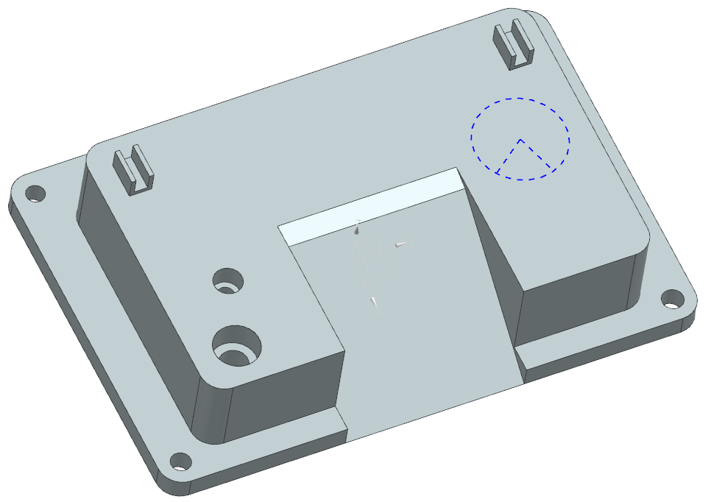
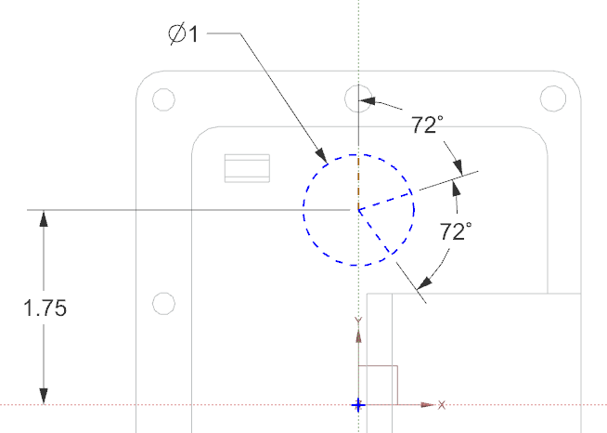
Feature Name: CIRCULAR_PATTERN
Feature Type: Sketch
72° lines created to aid in authoring 3D annotations

Slide 17
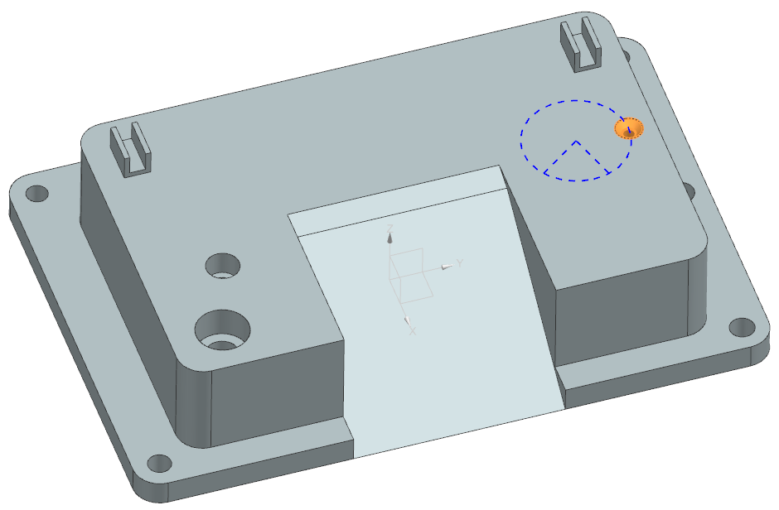
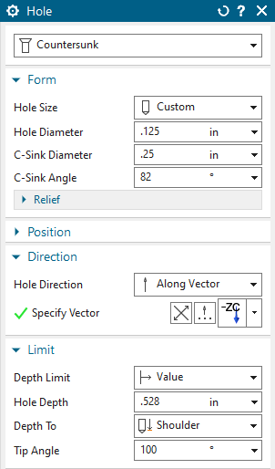
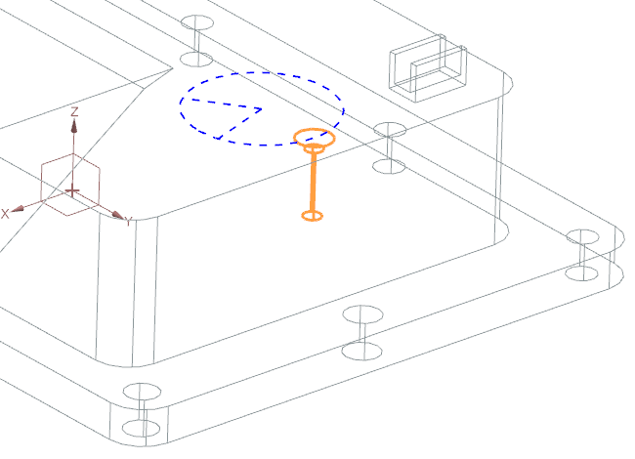
Feature Name: 8-COUNTERSUNK_DRILL
Feature Type: Hole - (Countersunk)
Position this hole at “3:00”
It will be the pattern leader of the next feature

Slide 18
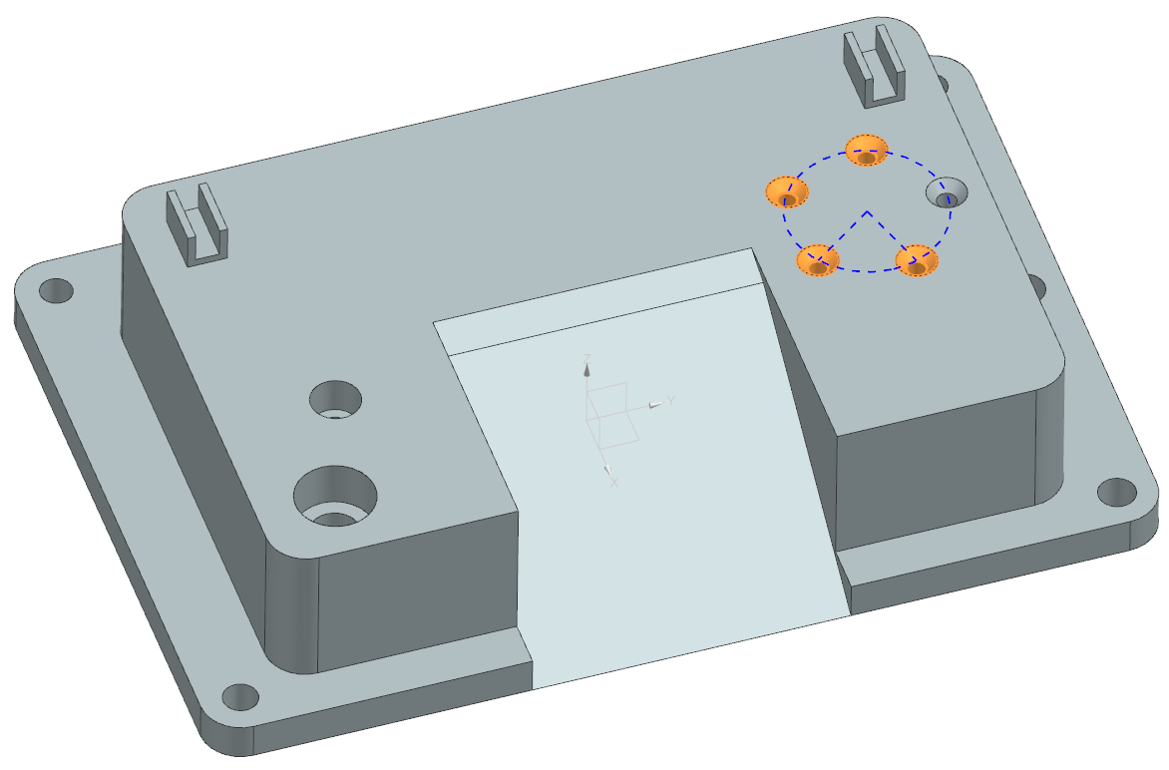
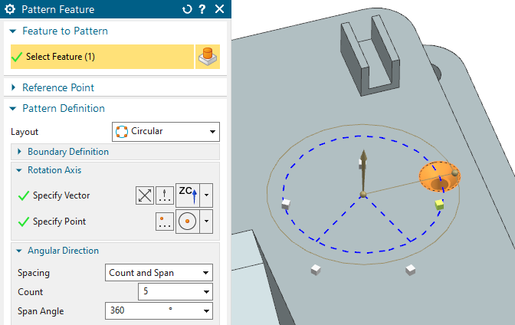
Feature Name: 9-CIRCULAR_PATTERN
Feature Type: Circular Pattern

Slide 19
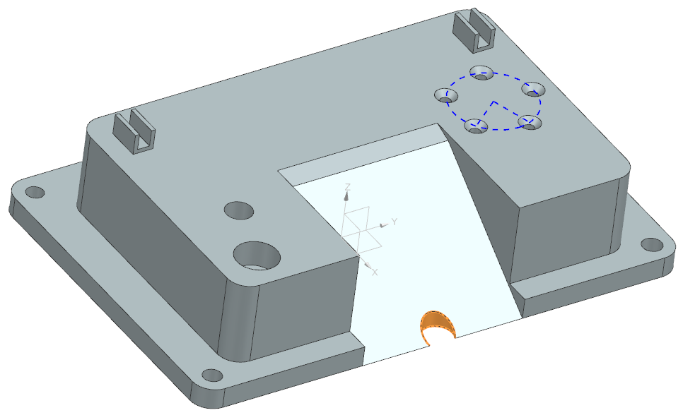
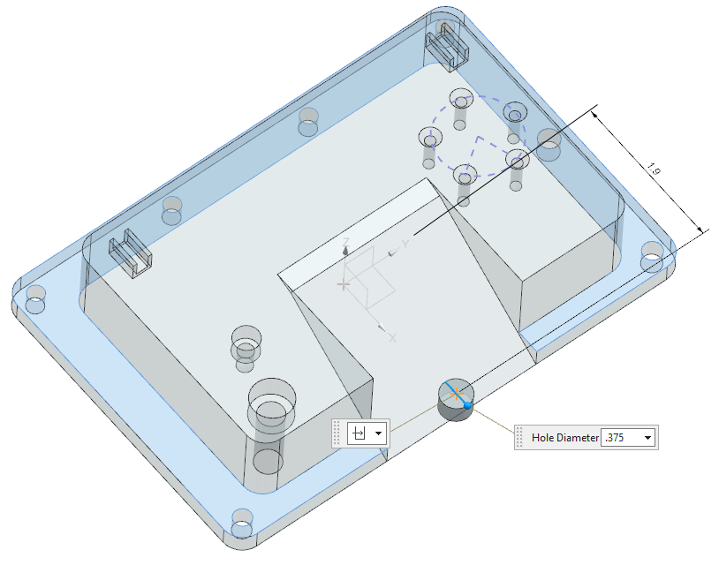
Feature Name: 10-PARTIAL_ANGLED_SURFACE
Feature Type: Circular Pattern
*The intent was to have hole on an angled surface
With a cut greater than 180 degrees, but less than 360
Offset from Y axis

Slide 20
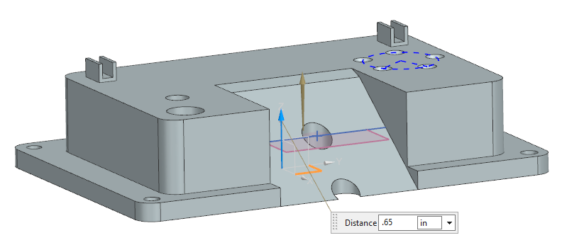
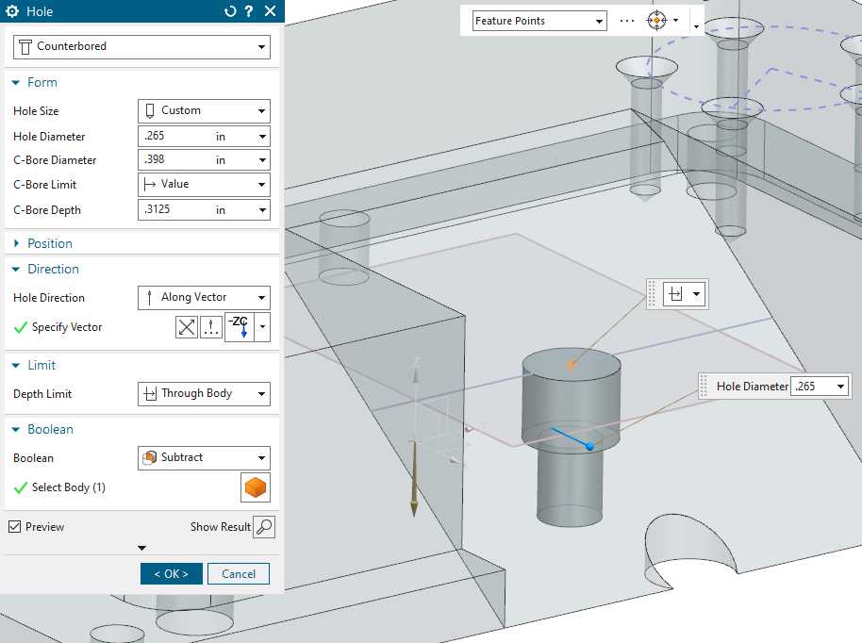
Feature Name: 11-COUNTERBORE_ANGLED_SURFACE
Feature Type: Hole (Counerbored)
Plane is .65 offset from the XY plane
Hole center is at centerline of curve intersecting plane on ramp
Hole axis is on the Z axis (normal to plane)

Slide 21
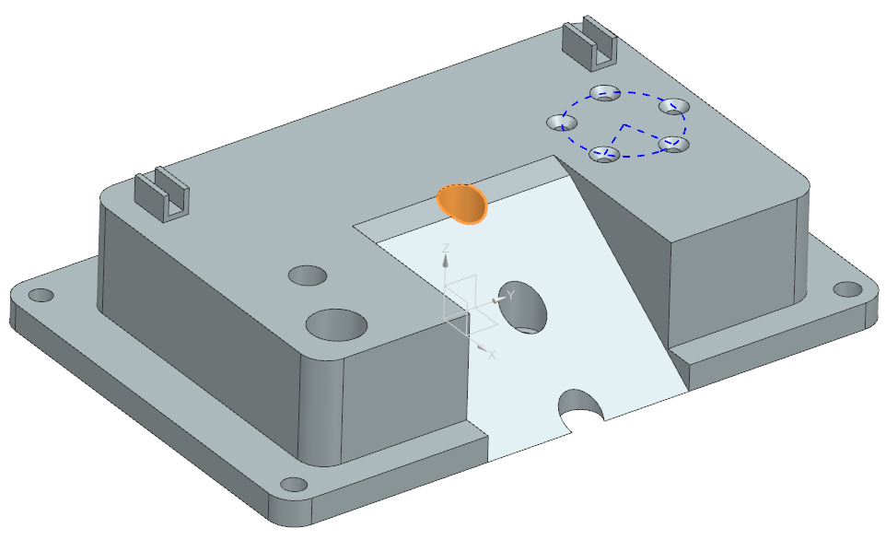
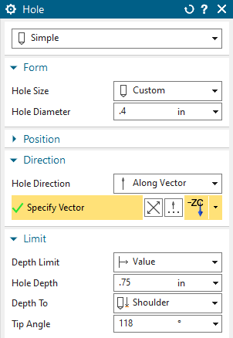
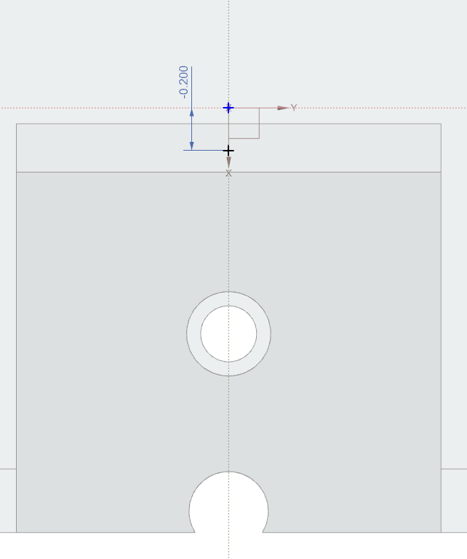
Feature Name: 12-CONVEX_3_SURFACES
Feature Type: Hole
*The intent was to have hole crossing multiple surfaces, resulting in at least 4 edge curves.
Coincident to XZ plane

Slide 22
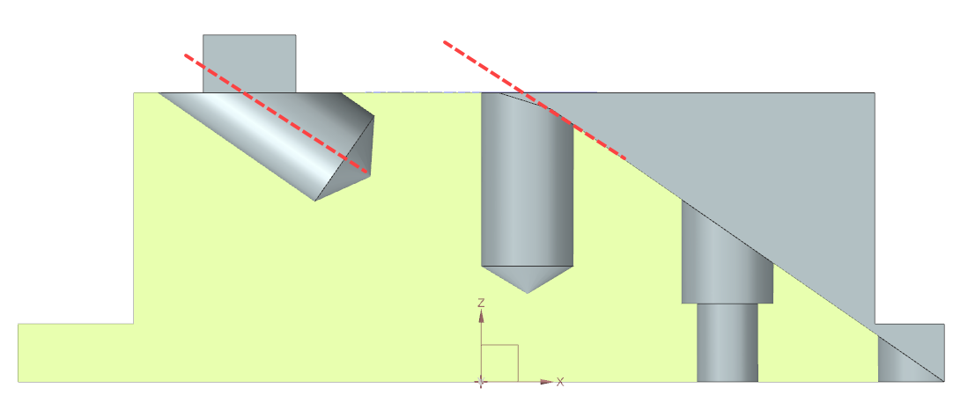
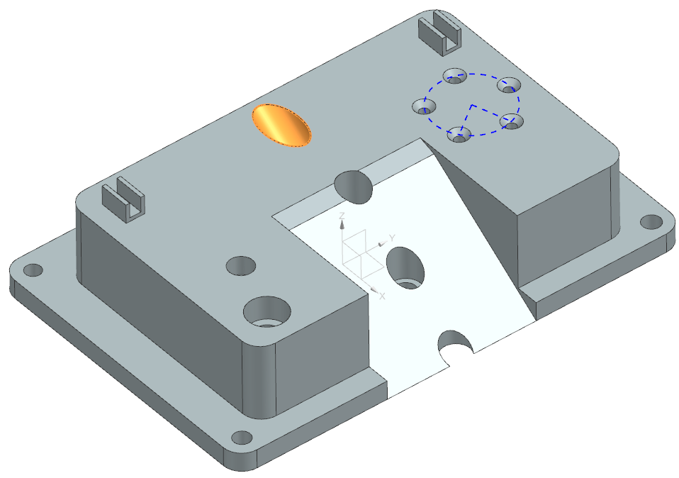
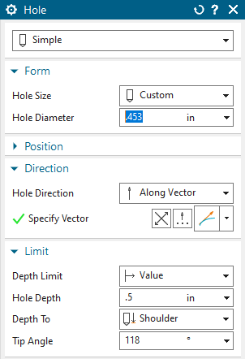
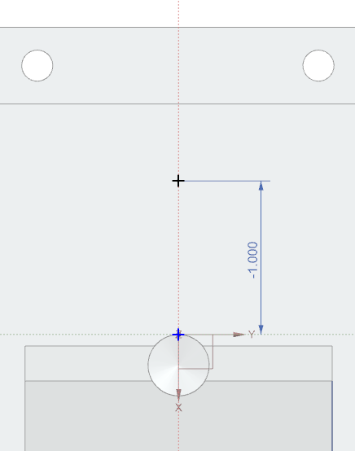
Feature Name: 13-ANGLE
Feature Type: Hole
Axis parallel to ramp
Coincident to
XZ plane

Slide 23
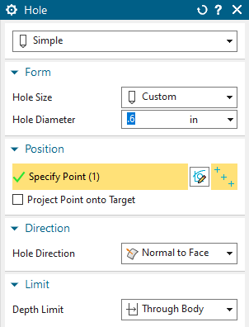
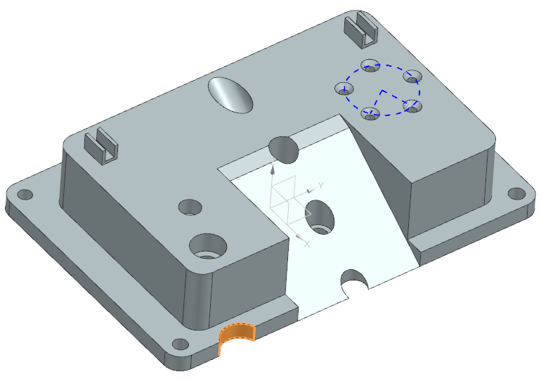
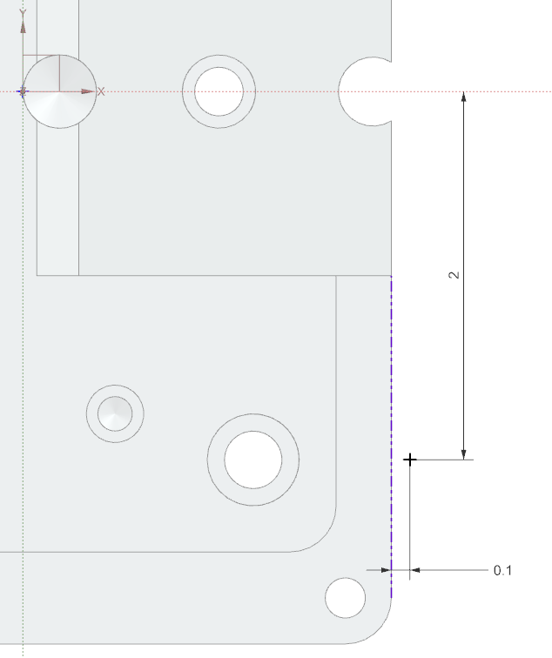

Feature Name: 14-PARTIAL_HOLE
Feature Type: Hole
*The intent was to have a hole less than 180 degrees.
Create one hole, it will be mirrored in the next feature

Slide 24

Feature Name: Mirror Feature
Feature Type: Mirror
*The intent was to use a mirror feature.
Mirror using the XZ plane

Slide 25



Feature Name: 15-THRU_SELECTED
Feature Type: Hole
*The intent was to cut using a selected surface as the depth.
Up to this surface
It should not cut through this clip at all.

Slide 26

Feature Name: Logo
Feature Type: Extrude
*Position of this feature is not critical.
A .dxf of this is available.

Slide 27
Annotations & Saved Views

Slide 28

View Name: 00_MODEL_ONLY_BACK

Slide 29

View Name: 00_MODEL_ONLY_FRONT

Slide 30

View Name: 01_NOTES
*Each numbered item is created as an individual note feature for a total of
6 notes, and one feature control frame.
A text file with the text is available.

Slide 31

View Name: 02_DATUMS

Slide 32

View Name: 04_FRONT_RIGHT

Slide 33

View Name: 05_BACK_UNDER

Slide 34

View Name: 06_TOP_LOWER

Slide 35

View Name: 07_SLOPE_FRONT

Slide 36

View Name: 09_LEFT

Slide 37

View Name: 08_SLOPE_SECTION

